Slide 1
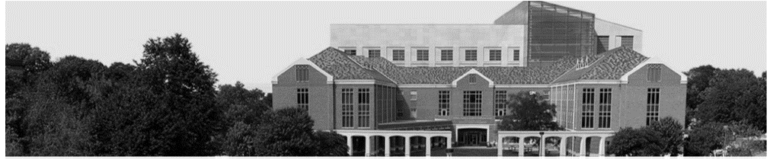

STUN: Secret-Free Trust-Establishment For Underground Wireless Networks
Ebuka Oguchi, Nirnimesh Ghose, Mehmet C. Vuran
School of Computing
SIXTH WORKSHOP ON 5G & BEYOND WIRELESS SECURITY , IEEE INFOCOM 2022
May 2 – 5, 2022

Slide 2
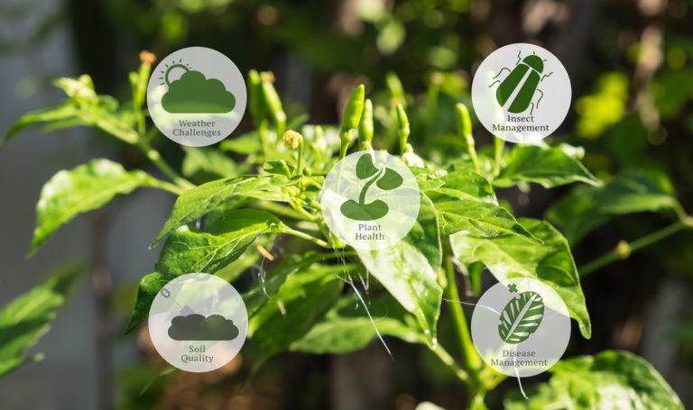
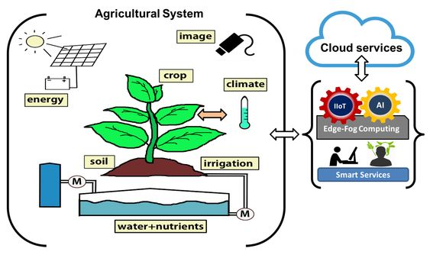
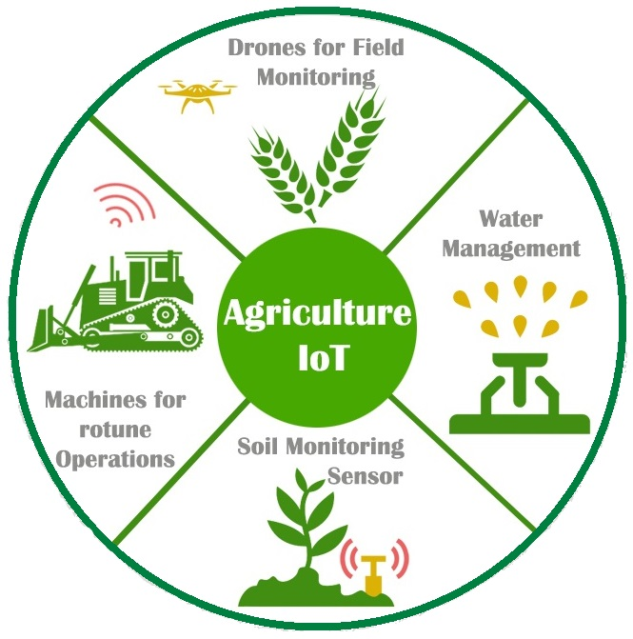
Background
Fig 1: Ag-IoT
Agricultural Internet of Things (Ag-IoT):
Increased Productivity in farm yields
Wireless Enabled smart farming
Soil monitoring, Plant health, smart irrigation, etc.

Slide 3
Motivation
Safer automated farming practices to prevent various threats like active signal injection attacks.
Secured transmission and Reception of wireless sensor data.
Data collected by the sensors can be secured by initial trust establishment.
Initial trust establishment includes authentication and secure key establishment between underground sensor and over the air gateway .

Slide 4
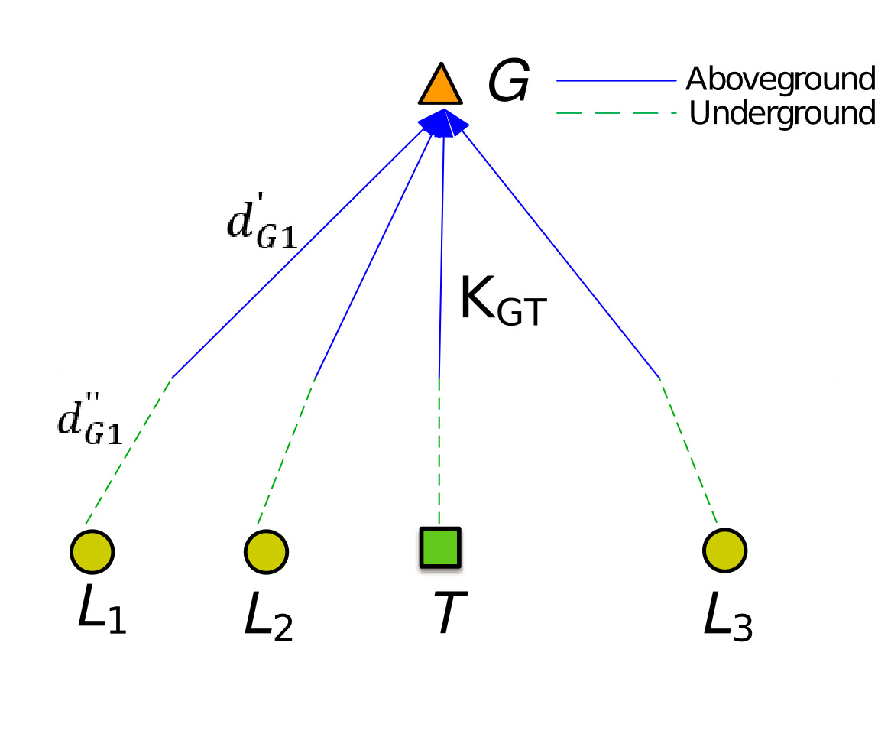
Objectives
To develop a secret free trust establishment for underground wireless communication.
Secure key establishment by performing Message Integrity verification using hard to forge wireless properties.
Authentication between the trusted node and gateway node
We show that the security of STUN is comparable to unbalance oil and Vinegar public key cryptographic scheme.
Legitimate Nodes
Trusted Node
Gateway
Adversary (M)

Slide 5
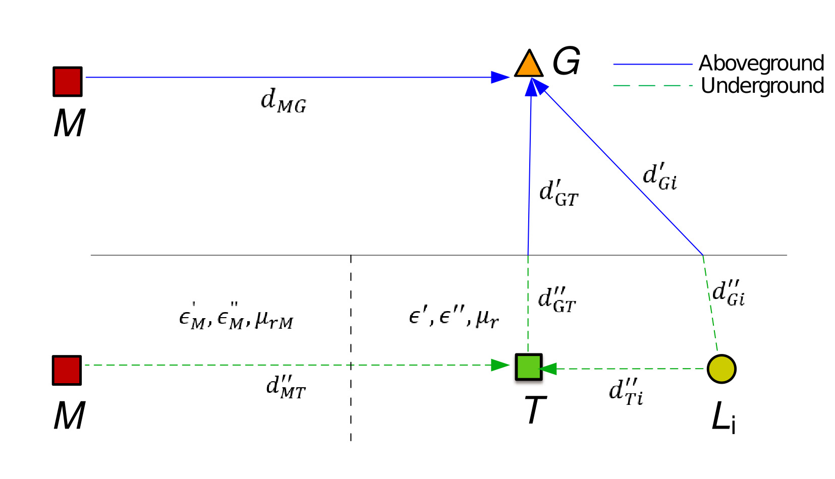
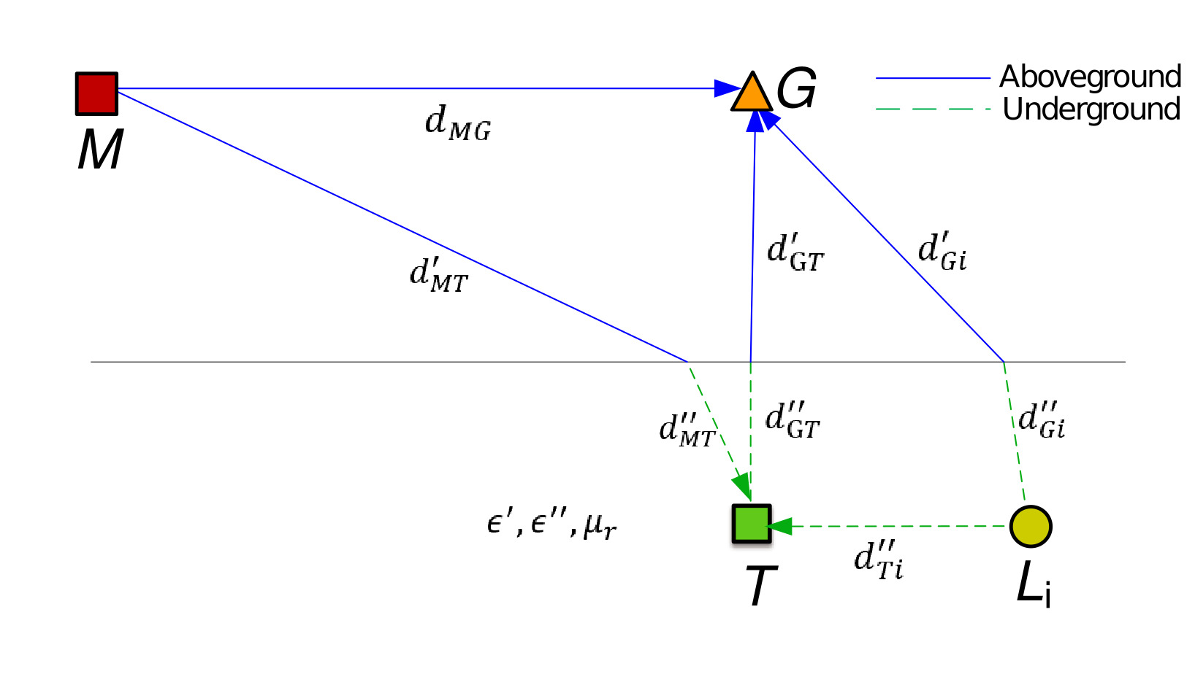
Threat Model
Type 1 Adversary
Type 2 Adversary
Type 1 adversary which attempts to inject its signals simultaneously at G and T
Adversary is outside the perimeter of the farm.
Type 2 adversary can deploy additional nodes above and underground to achieve the receive signal strength (RSS) at G and T

Slide 6


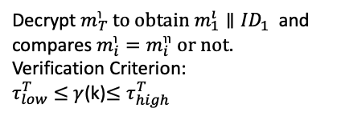

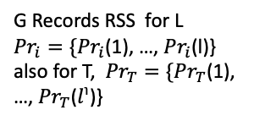
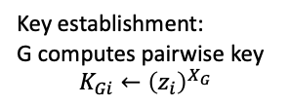
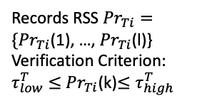
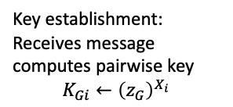
STUN: Trust Establishment Protocol
L
G
T
Initialization
Sync Message
Sync Message
Compute and transmit $m_{i}←ID_{i},z_{i}$
Compute and transmit $m_{i}←ID_{i},z_{i}$
Records RSS ${Pr}_{Ti}={\{Pr}_{Ti}$(1), …, ${Pr}_{Ti}$(l)}
Verification Criterion:
$τ_{low}^{T}≤$ ${Pr}_{Ti}$(k)$≤τ_{high}^{T}$
G Records RSS for L ${Pr}_{i}={\{Pr}_{i}$(1), …, ${Pr}_{i}$(l)} also for T, ${Pr}_{T}={\{Pr}_{T}$(1), …, ${Pr}_{T}$($l^{℩}$)}
Transmit $m_{T}≔{AE}_{K_{GT}}(m_{1}^{ı}∥{ID}_{1},…,m_{n}^{ı}∥{ID}_{n})$
Decrypt $m_{T}^{℩} to obtain m_{1}^{ı}∥{ID}_{1}$ and compares ${m_{i}^{℩}=m}_{i }^{℩℩} or not.$
Verification Criterion:
$τ_{low}^{T}≤$ $γ$(k)$≤τ_{high}^{T}$
Key establishment: Receives message computes pairwise key
$$K_{Gi}←{\left(z_{G}\right)}^{X_{i}}$$
Compute and transmit $m_{G}←ID_{G},z_{G}$
Key establishment:
G computes pairwise key
$$K_{Gi}←{\left(z_{i}\right)}^{X_{G}}$$

Slide 7
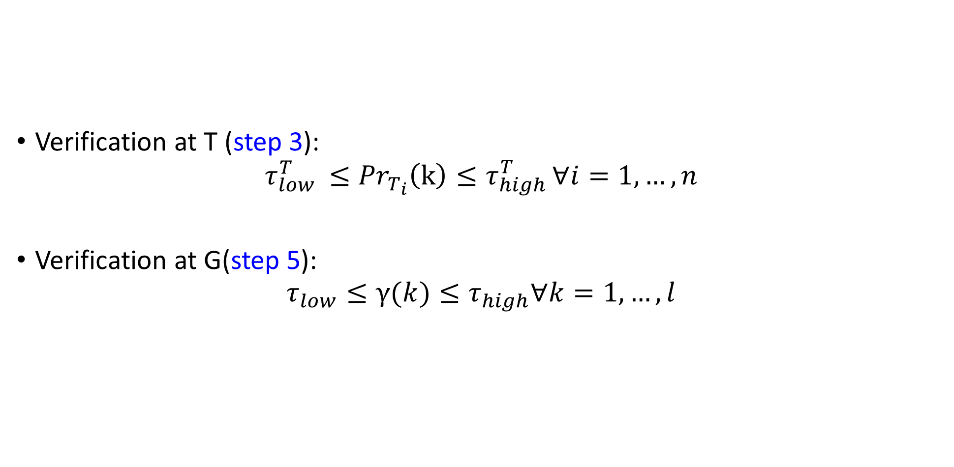
STUN: Received signal strength Verification
Verification at T (step 3):
$$τ_{low }^{T}≤{Pr}_{T_{i}}\left(k\right)≤τ_{high }^{T}∀i=1, …, n$$
Verification at G(step 5):
$$τ_{low}≤γ(k)≤τ_{high}∀k=1, …, l$$

Slide 8
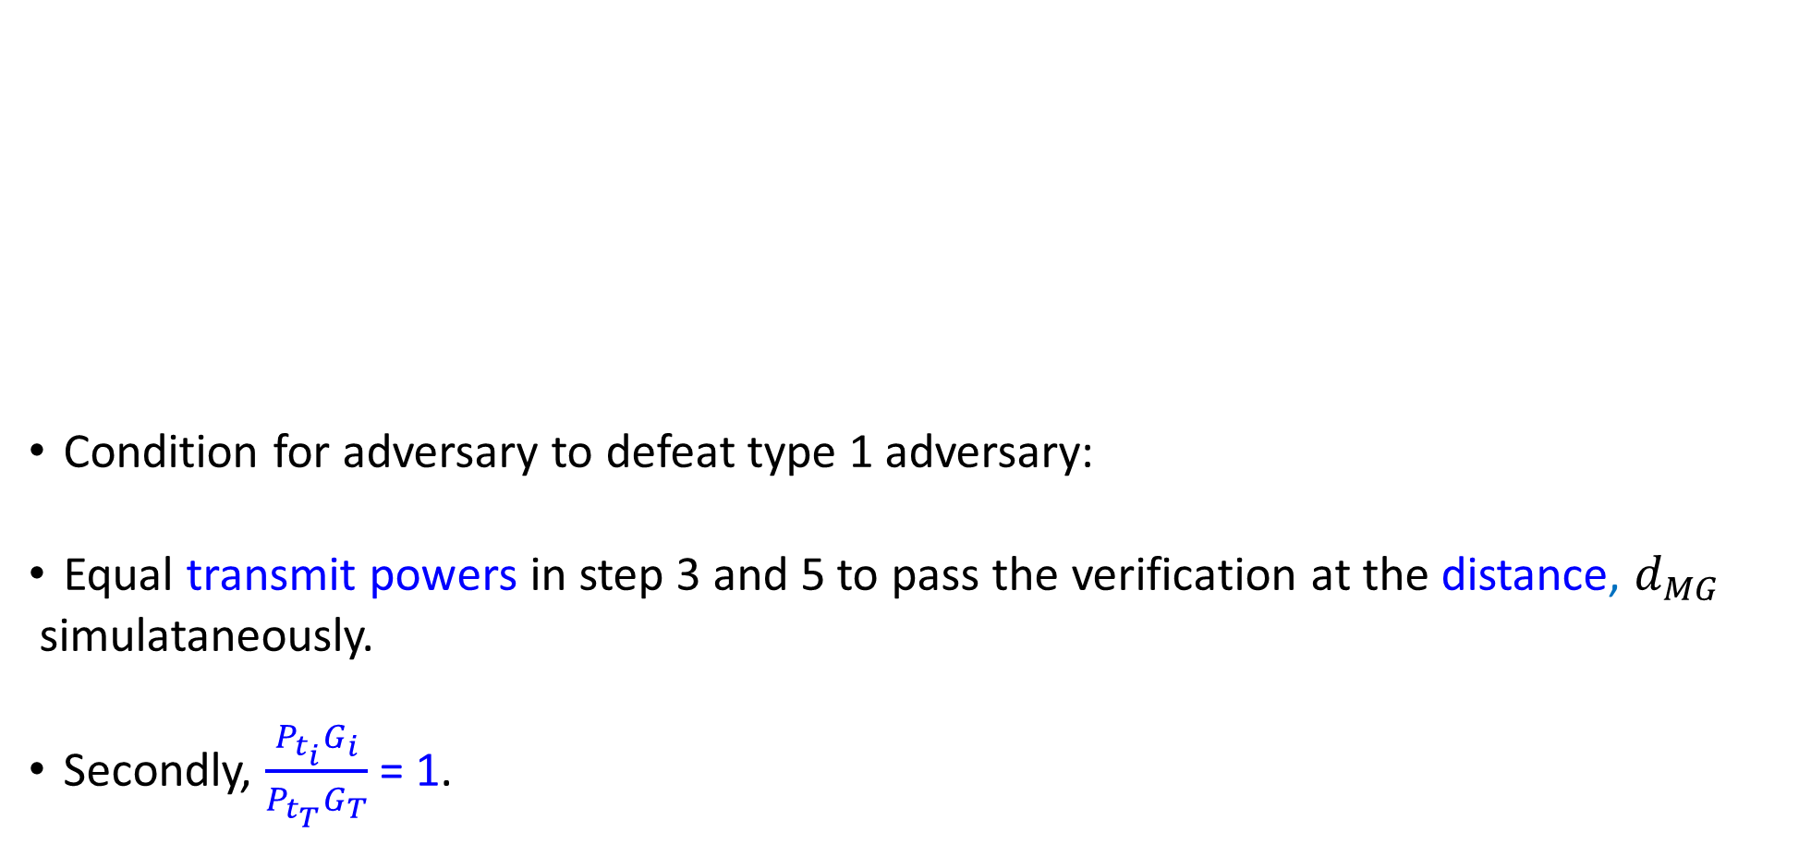
Evaluation: Type 1 Adversary
Condition for adversary to defeat type 1 adversary:
Equal transmit powers in step 3 and 5 to pass the verification at the distance, $d_{MG}$
simulataneously.
Secondly, $\frac{P_{t_{i}}G_{i}}{P_{t_{T}}G_{T}}$ = 1.

Slide 9
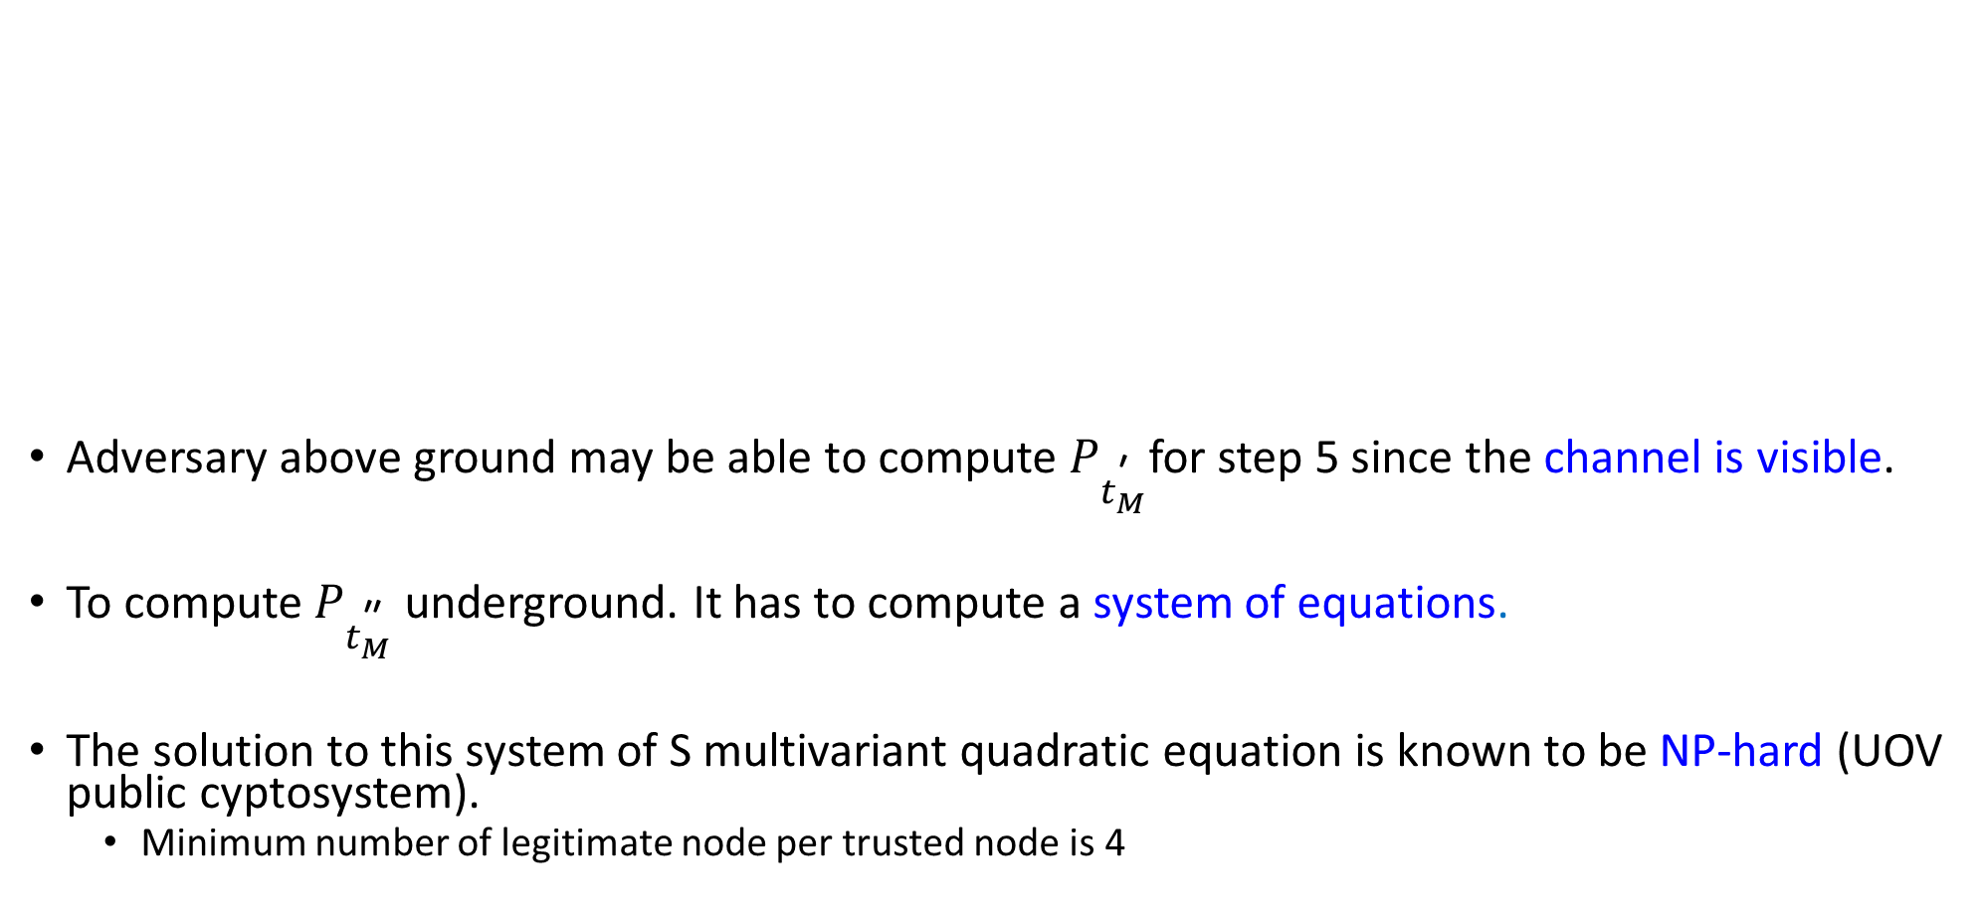
Evaluation: Type 2 Adversary
Adversary above ground may be able to compute $P_{t_{M}^{\text{′}}}$for step 5 since the channel is visible.
To compute $P_{t_{M}^{\text{″}}}$ underground. It has to compute a system of equations.
The solution to this system of S multivariant quadratic equation is known to be NP-hard (UOV public cyptosystem).
Minimum number of legitimate node per trusted node is 4

Slide 10
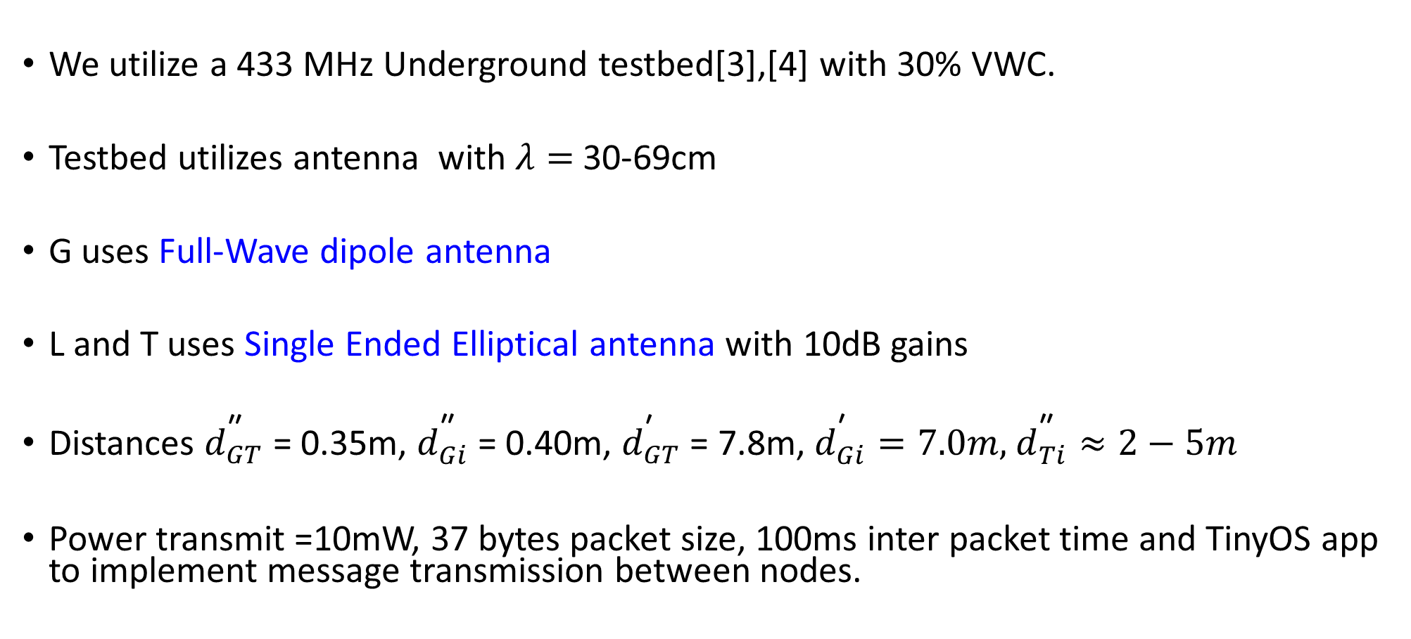
Experimental Setup
We utilize a 433 MHz Underground testbed[3],[4] with 30% VWC.
Testbed utilizes antenna with $λ=$30-69cm
G uses Full-Wave dipole antenna
L and T uses Single Ended Elliptical antenna with 10dB gains
Distances $d_{GT}^{\text{″}}$ = 0.35m, $d_{Gi}^{\text{″}}$ = 0.40m, $d_{GT}^{\text{′}}$ = 7.8m, $d_{Gi}^{\text{′}}=7.0m,$ $d_{Ti}^{\text{″}}≈2−5m$
Power transmit =10mW, 37 bytes packet size, 100ms inter packet time and TinyOS app to implement message transmission between nodes.
[3] X. Dong, M. C. Vuran, and S. Irmak, “Autonomous precision agriculture through integration of wireless underground sensor networks with center pivot irrigation systems,” Ad Hoc Networks, vol. 11, no. 7, pp. 1975– 1987, 2013
[4] A. R. Silva and M. C. Vuran, “Empirical evaluation of wireless underground-to-underground communication in wireless underground sensor networks,” in Proc. of International Conference on Distributed Computing in Sensor Systems. Springer, 2009, pp. 231–244.

Slide 11
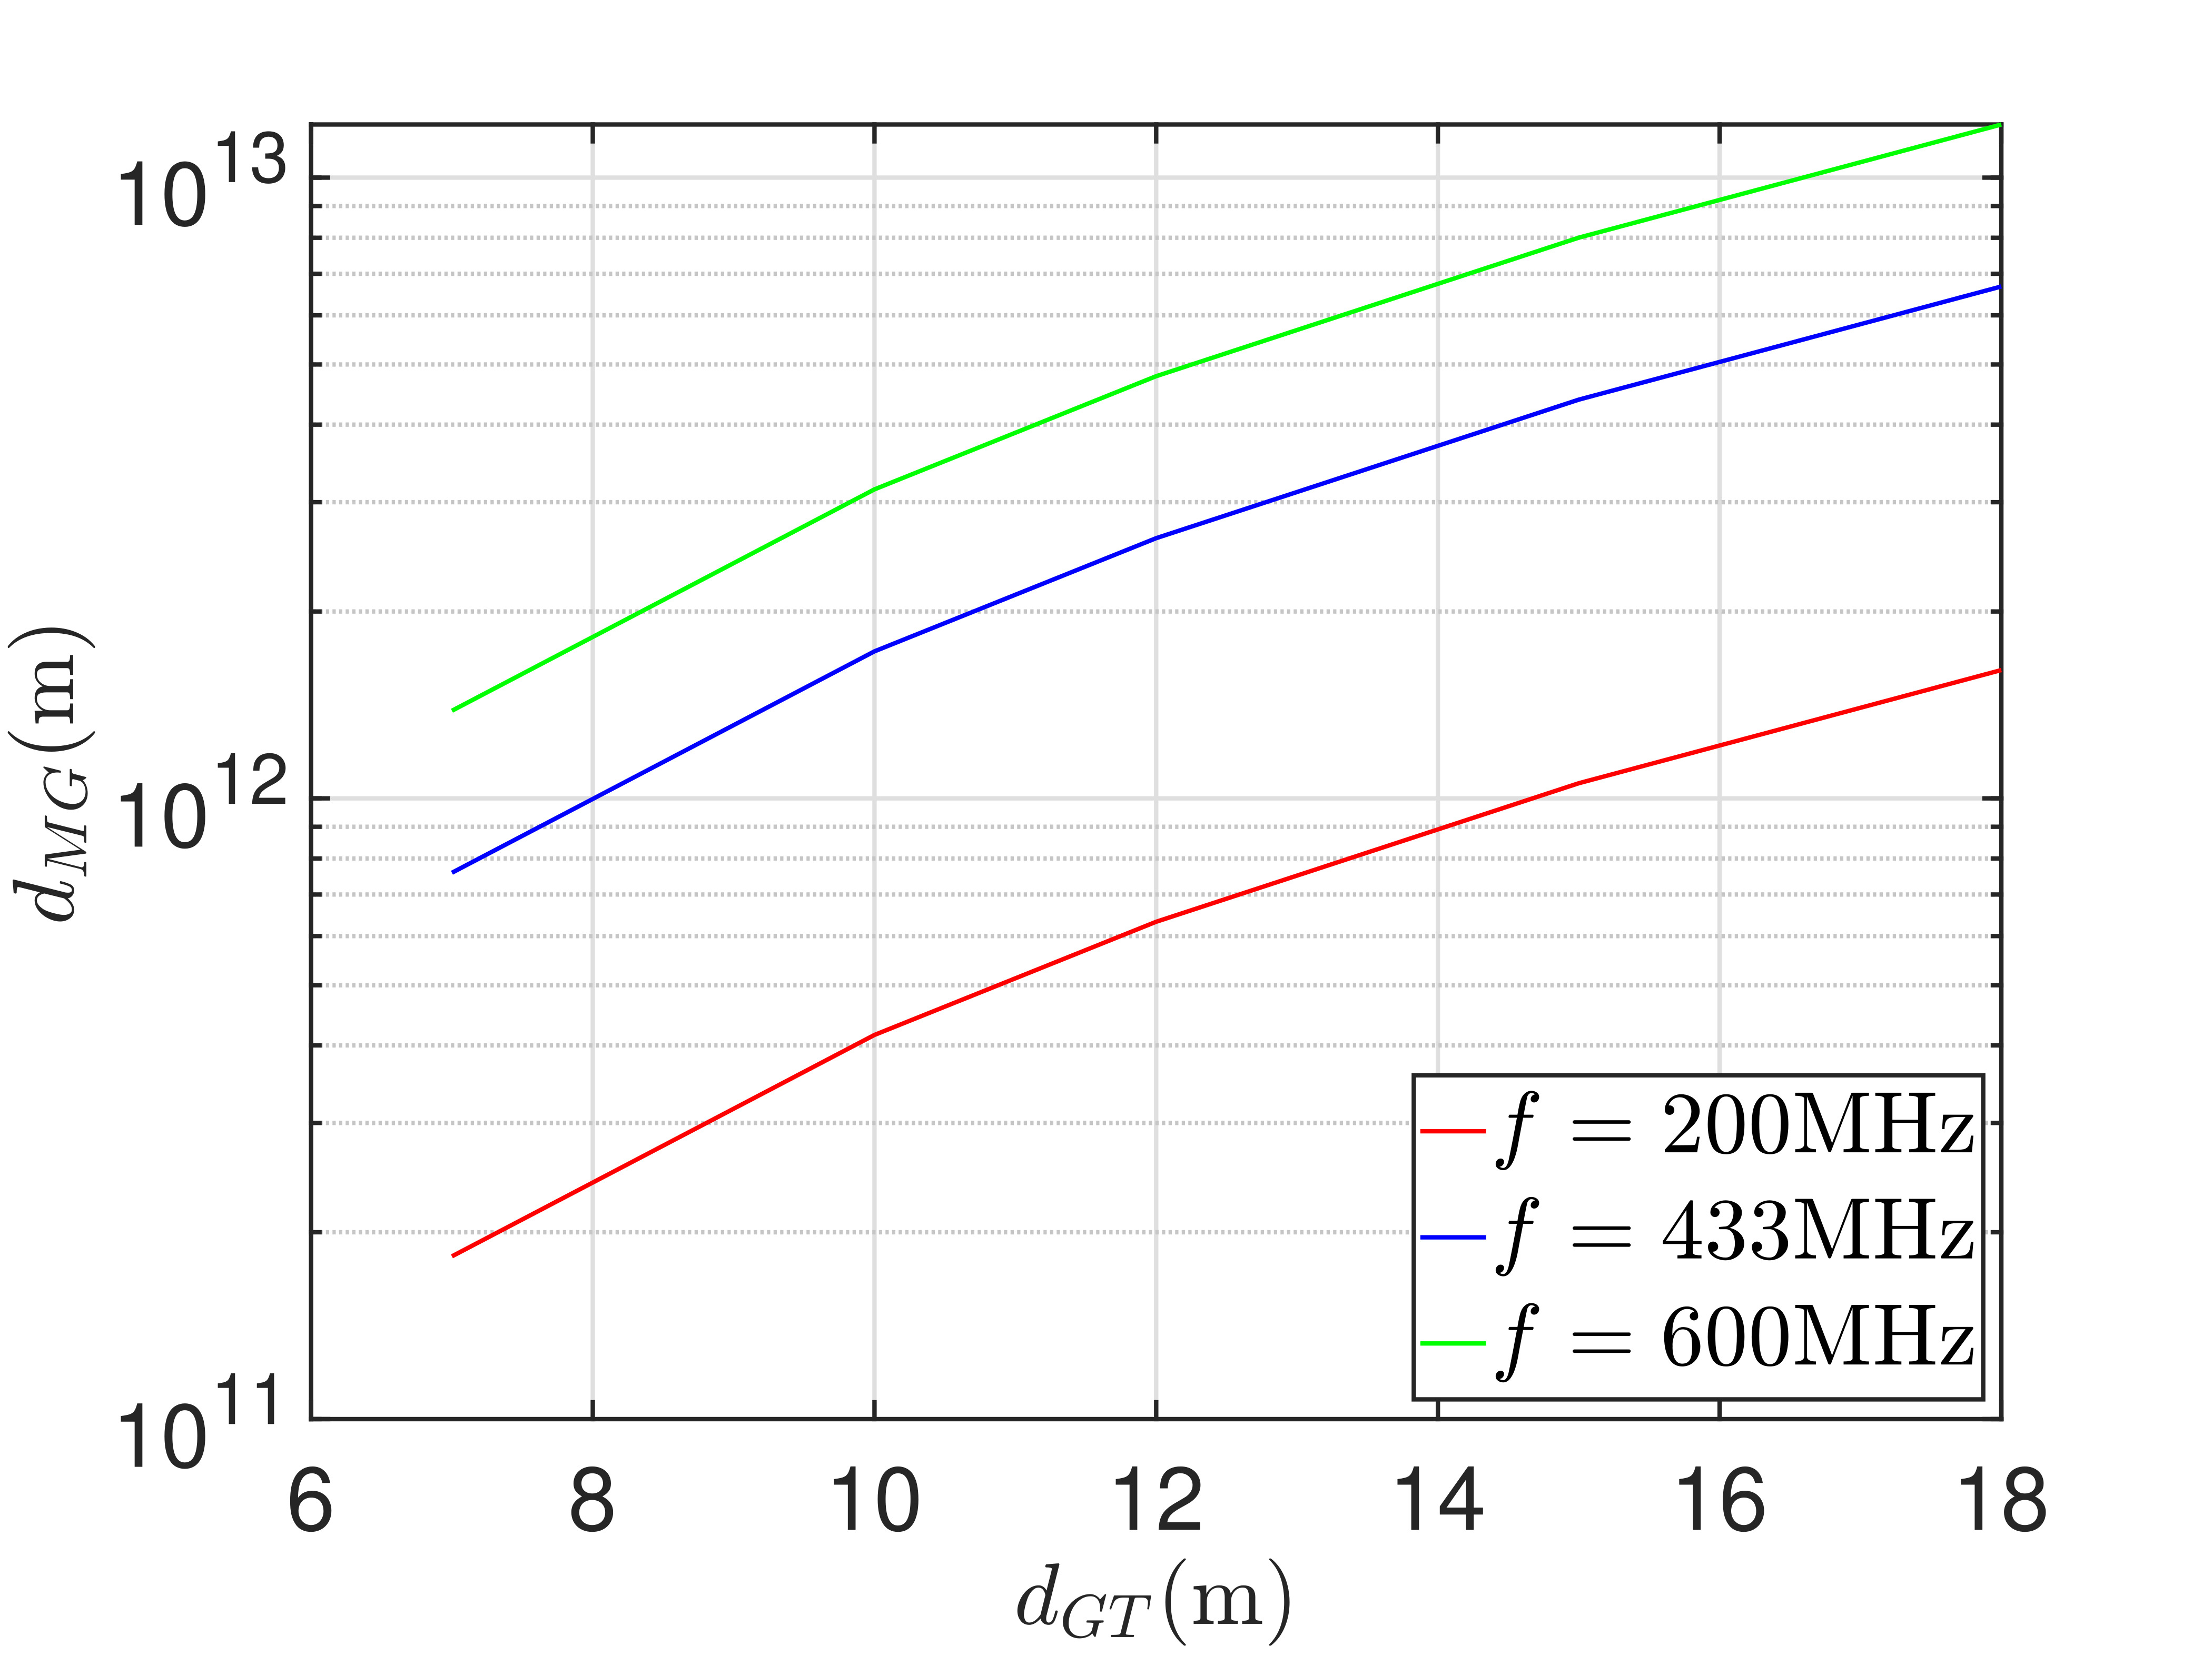
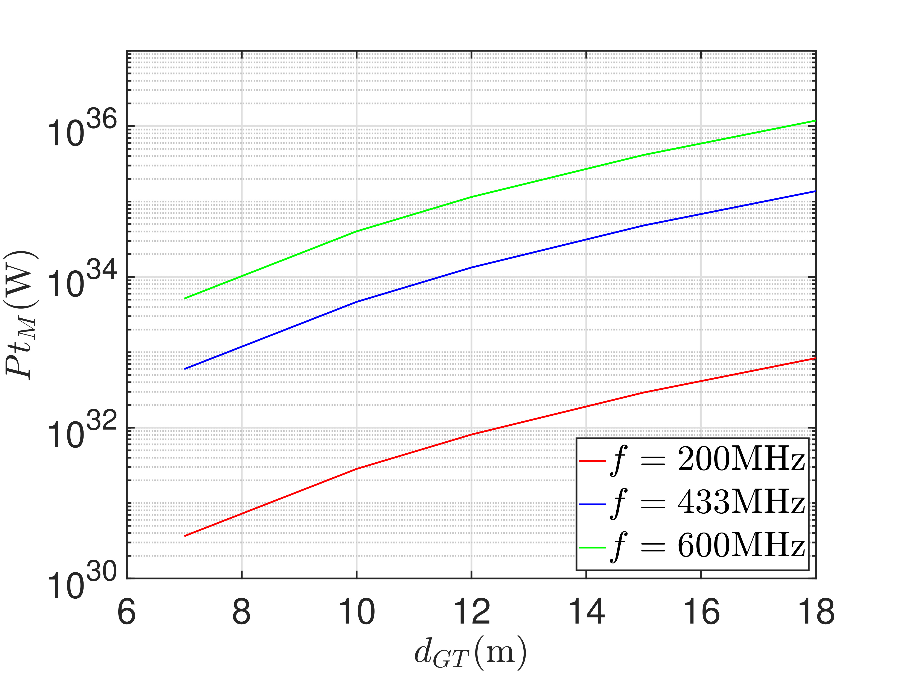
Experimental Evaluation: Type 1 Adversary
Fig 8: Plot of distance and power transmitted against distance between T and G.
M must be place extremely far from G
Step 3 fails
High attenuation.
Adversary needs to transmit very high power
L trasmit on 3W
Very high
Power
Very high
distance

Slide 12
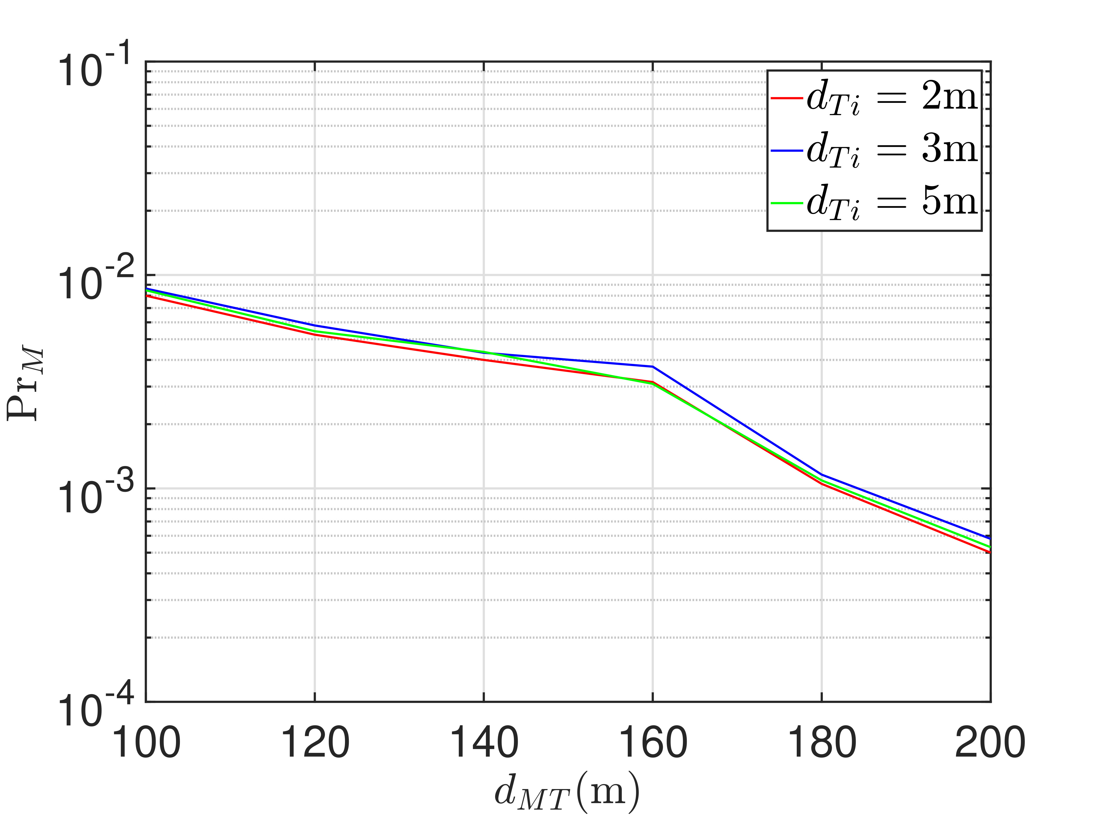
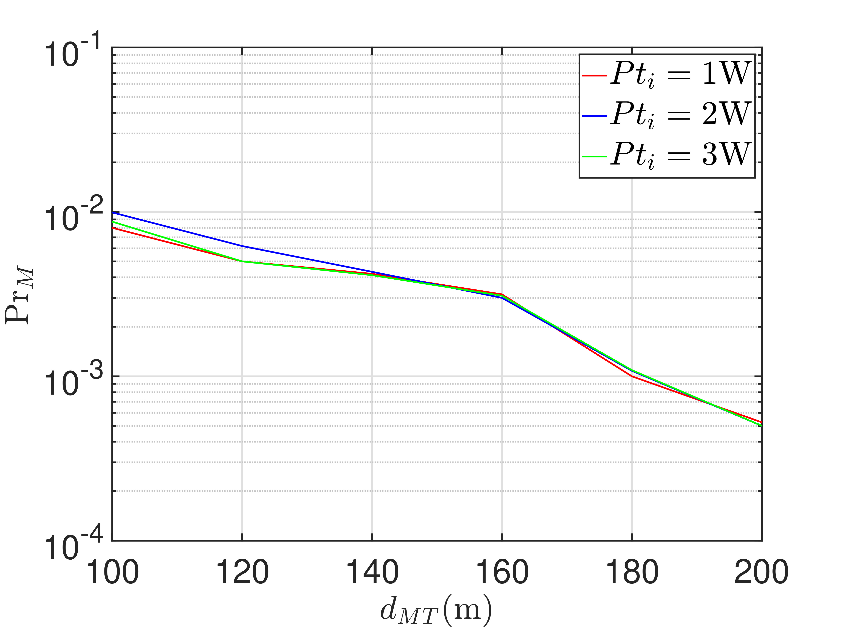
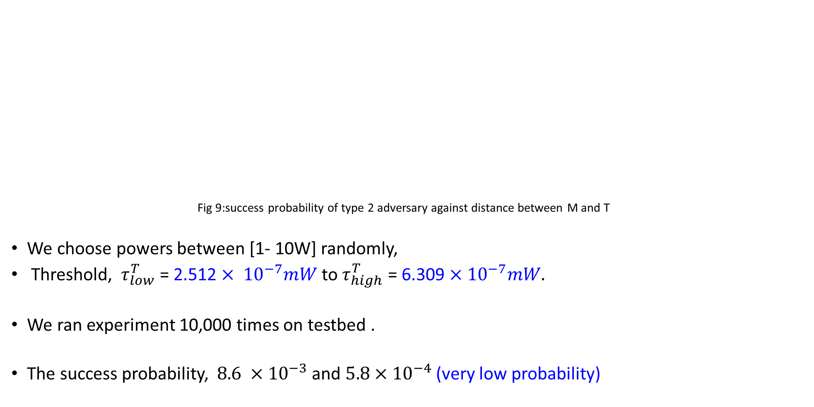
Experimental Evaluation: Type 2 Adversary
Fig 9:success probability of type 2 adversary against distance between M and T
We choose powers between [1- 10W] randomly,
Threshold, ${ τ}_{low}^{T}$ = 2.512 $× {10}^{−7}mW$ to${ τ}_{high}^{T}$ = 6.309 $×$ ${10}^{−7}mW.$
We ran experiment 10,000 times on testbed .
The success probability, $8.6 ×{10}^{−3}$ and $5.8×{10}^{−4}$ (very low probability)
Very low Success probability
Very low Success probability

Slide 13
Conclusion and Future Work
We address the problem of a secret free secure bootstrap for COTS underground nodes with an aboveground gateway.
We used hard to forge underground wireless propagation laws to achieve in band node authentication and secret establishment.
We proved that STUN has security equivalent to UOV scheme in cryptography.
In the future, we plan to experimentally evaluate and optimize the placement of trusted nodes to cover an agricultural farm and also develop security for G-to-L communication link.
Q&A

